Slide 1
GBA Branding Guide and Logos

Slide 2
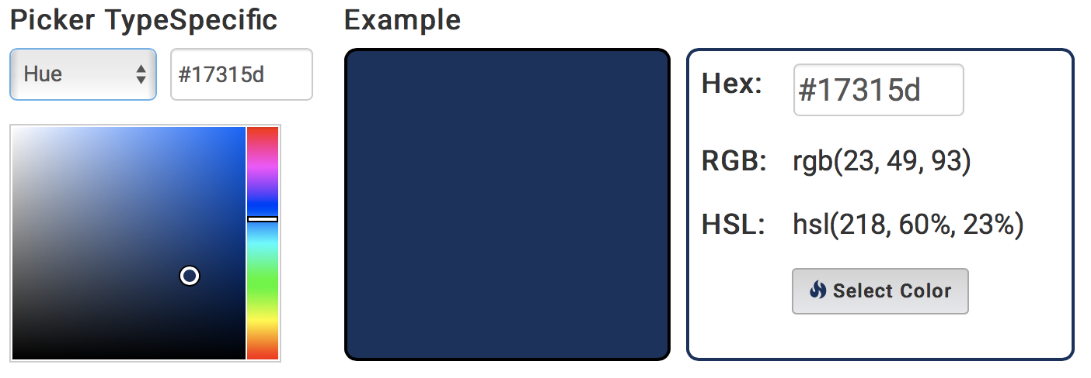
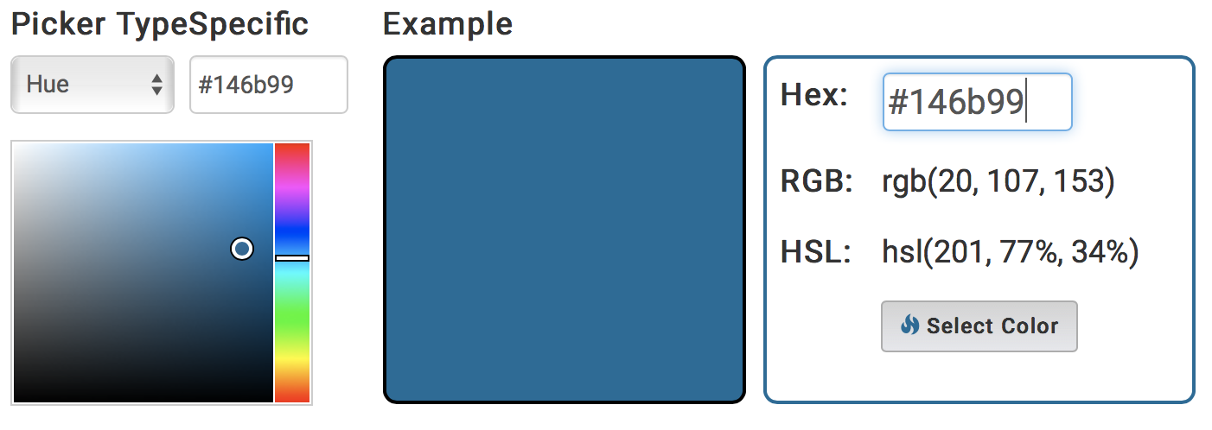
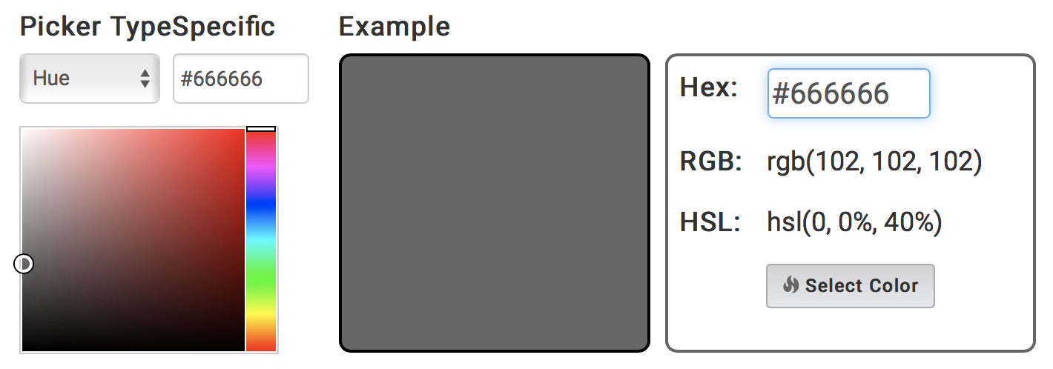
GBA Style Guide - Color Codes
Dark Blue (primary logo) #17315D rgb (23, 49, 93) cmyk (75, 47, 0, 64)
Light Blue #146b99 rgb (20, 107, 153) myk (91, 53, 33, 10)
Grey #666666 rgb (102, 102, 102) cmyk (0, 0, 0, 60)

Slide 3
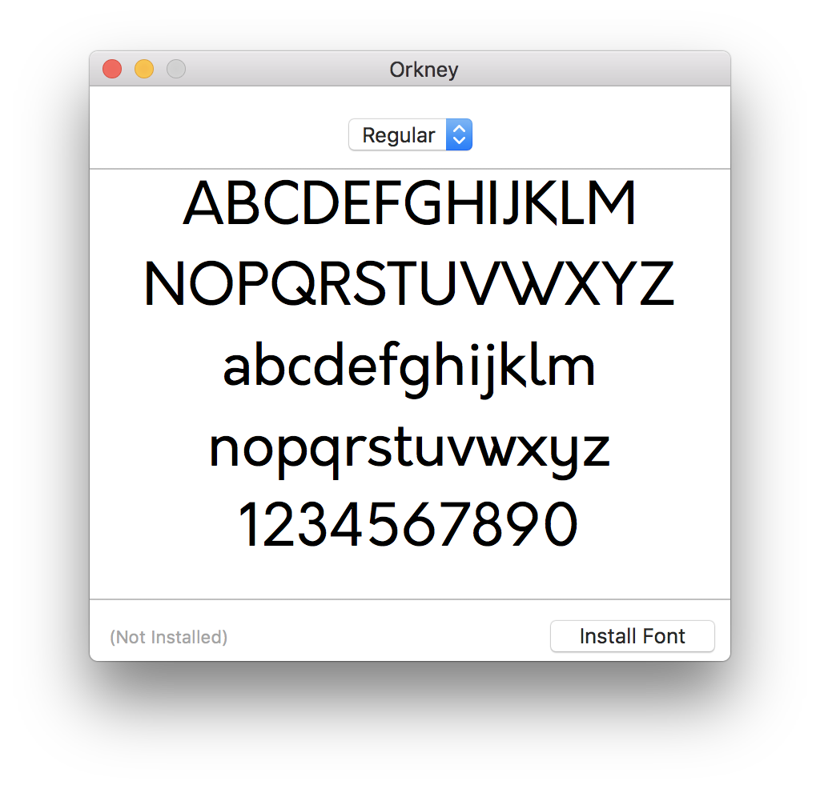
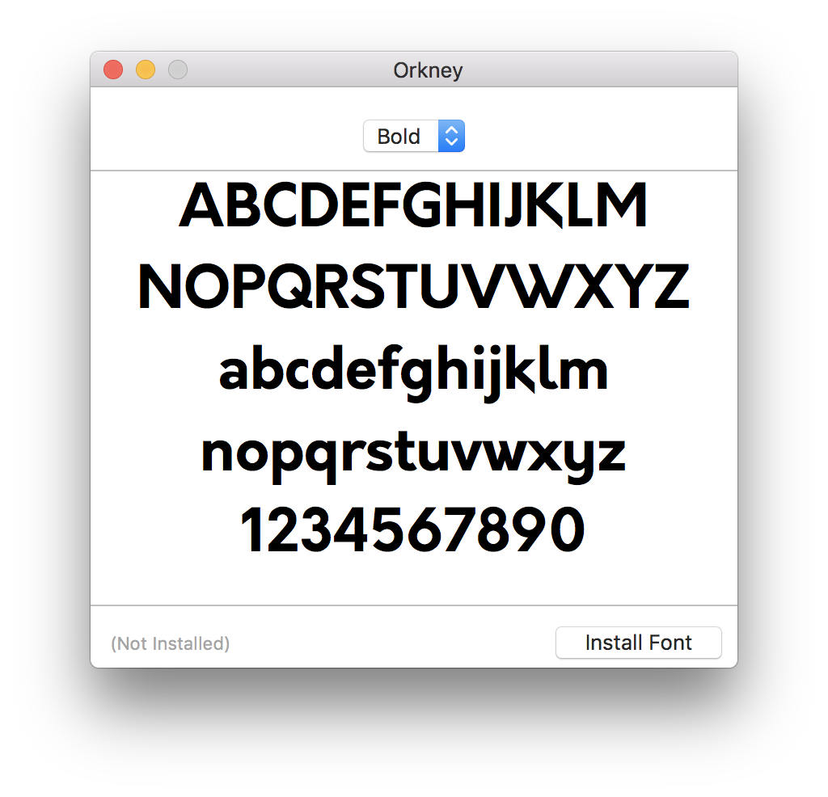
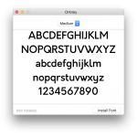
GBA Style Guide – Font Orkney
Download GBA Branding and Logos

Slide 4
GBA Style Guide – Logos JPEG
Blue JPEG
Black JPEG
Grey JPEG
White on Black JPEG

Slide 5
GBA Style Guide – Logos Transparent PNG
Download Transparent Blue PNG
Download Transparent Black PNG
Download Transparent Grey PNG
Download White Transparent PNG

