Slide 1
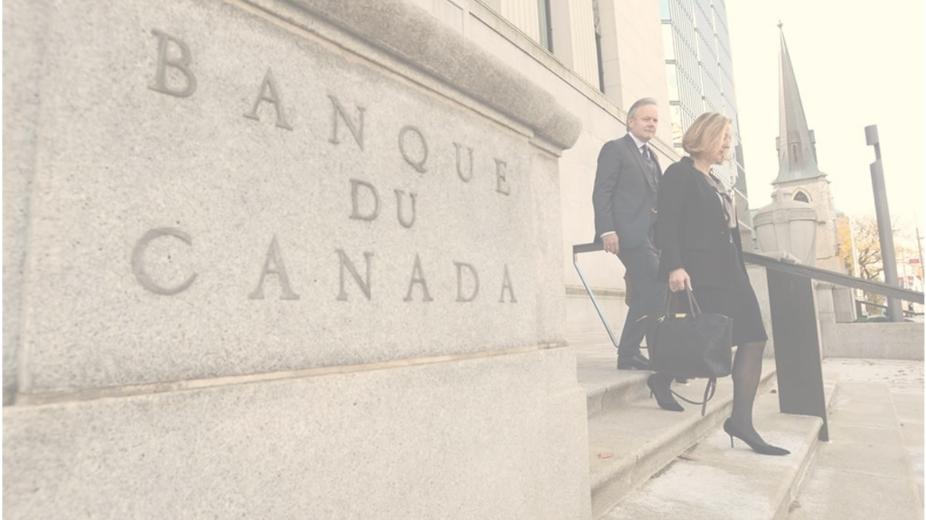
Blockchain and Security
Gerard Dache, Global President
Government Blockchain Association (GBA)
gerard.dache@GBAglobal.org

Slide 2
Introduction
Gerard Dache – President, GBA
Chapters in over 90 cities
Blockchain Certifications
Over 45 Working Groups
Including …..
Acquisition Management
Asset Management
Big Data
Budgeting, Acct & Transparency
Cannabis
Contract Management
Cybersecurity
Economic Analysis
Education & Training
Energy
Financial Regulatory & Compliance
Government Ontology
Health Care
Identity Management
Insurance
Intellectual Property (IP)
Land Titling
Law Enforcement
Legislative & Policy
Mining & Cryptocurrency
Records Management
Smart City
Supply Chain
Taxes
Telcom, Internet & Comms
Voting

Slide 3
Agenda
The Threats are real
What is Blockchain?
Blockchain as a Security Solution
Blockchain Security Considerations
Government Regulations
GBA Resources Available

Slide 4
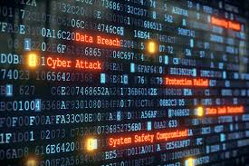
The Threats Are Real 3 Cyber 9/11 Scenarios
Blockchain May Be a Solution

Slide 5
Scenario #1
Knocking out basic services
Cyberattacks that cause major disruption to public services have happened many times in the real world.
Utilities are one vital resource. But it's not just power, water is another type of utility. If the quality of drinking water is called into question, and then manufacturers who rely on using untainted water for making drugs or food have a potential crisis

Slide 6
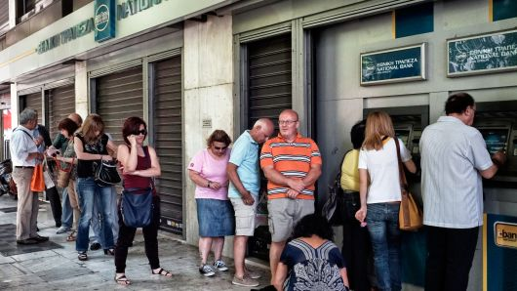
Scenario #2
A financial-sector attack that triggers a run
Financial regulators often talk about the risk of "contagion" as a result of an attack on banks or institutions like the New York Stock Exchange. The fear is that a cyberattack could send customers rushing to banks in a panic to pull out funds.
If consumers couldn't get cash out of ATM machines, if credit cards weren't functioning, that would be very problematic.

Slide 7
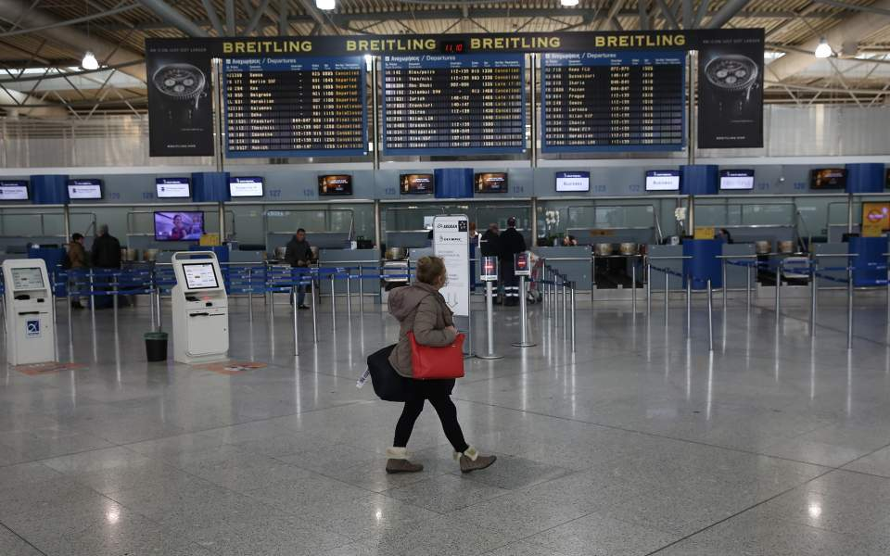
Scenario #3
Changing data so it's wrong
Criminals or nation-states could also change data, like financial information on balance sheets or commands going into an industrial machine, instead of merely stealing it or deleting it.
Integrity of data is key. If you lose your ability to trust the information that is coming out of the financial sector, that is when things can turn dark and very quickly.
Source: CNBC Published 18 Nov 2018 by Kate Fazzini

Slide 8
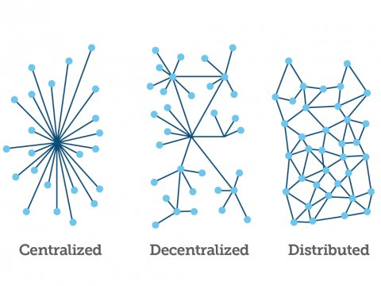
Centralized vs Decentralized Ledgers

Slide 9
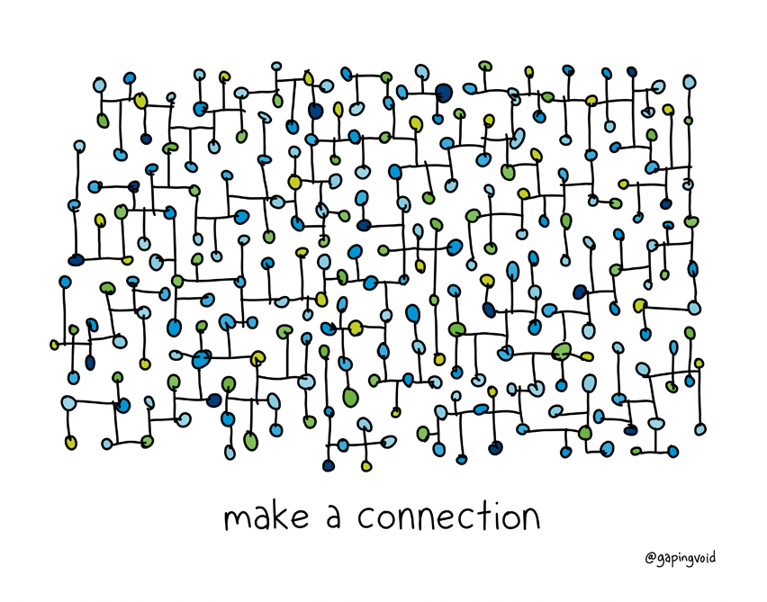
Blockchain is a Decentralized Ledger
Shared Record Book/Ledger
Everybody has a copy
Constantly Updated

Slide 10
Blockchain Attributes

Slide 11
Google Trends Search: “Blockchain”
Lesotho | Malta | Iceland | Guernsey | Armenia | Portugal | Montenegro | Puerto Rico
Ghana | Netherlands | Latvia | Benin | Bangladesh | Croatia | Poland | Nicaragua
Nigeria | Cambodia | Botswana | New Zealand | Rwanda | Guam | Albania | Chile
St. Helena | United Arab Emirates | Andorra | Bolivia | Finland | Kyrgyzstan | Uruguay | Congo - Kinshasa
Liechtenstein | Monaco | Cameroon | Brunei | Lithuania | Thailand | Ecuador | Syria
Singapore | Uganda | Canada | Israel | Uzbekistan | Spain | RÃ©union | Angola
Luxembourg | Kosovo | United Kingdom | Vietnam | Czechia | Sri Lanka | Oman | El Salvador
Gibraltar | Estonia | Malaysia | Belarus | France | Azerbaijan | Senegal | Mexico
Antigua & Barbuda | Ukraine | Belgium | Haiti | Algeria | Taiwan | Peru | Sudan
Zimbabwe | Barbados | Georgia | Aruba | Bulgaria | Lebanon | Hungary | Honduras
CÃ´te dâ€™Ivoire | Cyprus | Nepal | Suriname | Jamaica | Paraguay | Zambia | Ethiopia
Papua New Guinea | Slovenia | Pakistan | French Polynesia | Morocco | Serbia | Iran | China
South Africa | Mauritius | Norway | Venezuela | Macedonia (FYROM) | Bahamas | Kuwait | Saudi Arabia
CuraÃ§ao | Austria | Laos | Kazakhstan | Trinidad & Tobago | Romania | Fiji | Japan
Hong Kong | Australia | Mongolia | Madagascar | Panama | Qatar | Libya | Guatemala
Switzerland | India | Myanmar (Burma) | Philippines | Namibia | Costa Rica | Bosnia & Herzegovina | Iraq
Bermuda | Ireland | Russia | Denmark | Tanzania | Italy | Egypt
Cayman Islands | Dominican Republic | Moldova | Colombia | Macau | Slovakia | Turkey
Isle of Man | Kenya | Germany | Sweden | Indonesia | Greece | Argentina
Jersey | Tunisia | South Korea | United States | Bahrain | Brazil | Jordan

Slide 12
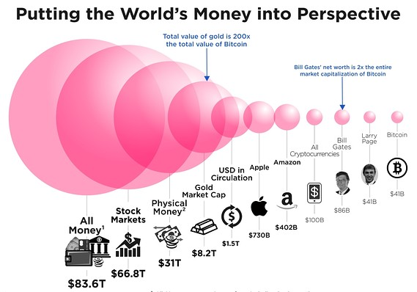
Market Cap
11/26/2018
Total Market: 128 B
Bitcoin: 70 Billion
XRP: 15 Billion
Ethereum: 12 Billion

Slide 13
Blockchain As a Security Solution
Trustless
Everyone can have access to everything…it is already compromised
Secure
Relies on cryptographic mechanisms to make tampering difficult and obvious
Very hard to create a verification signature
Very simple to validate a signature
Fault Tolerant
Many nodes all of which have all the data. Groups of malicious nodes are rejected.

Slide 14
Domain Name Server (DNS)
Central Authorities
Directs the internet
From a name: CNN.COM
To a server IP: 151.101.1.67

Slide 15
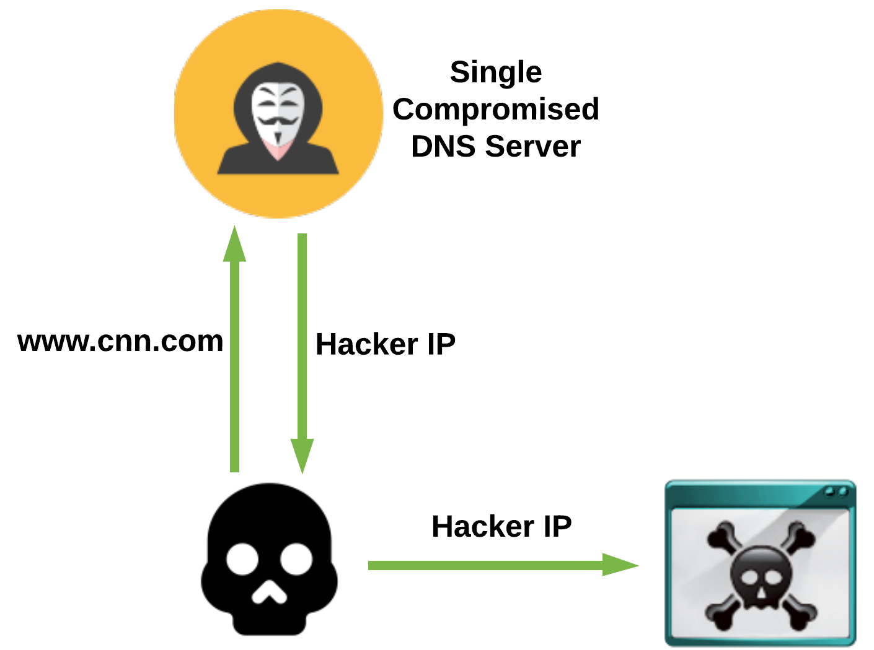
Example 1: Centralized DNS

Slide 16
DYN DNS Hack
Large DNS Provider
1
Single Point of Failure
2
Affected
3
Twitter, Spotify, Box, Github, AirBnB, Amazon, Reddit, Netflix
Distributed Denial of Service (DDoS)
4
Hijacked Internet of Things Devices

Slide 17
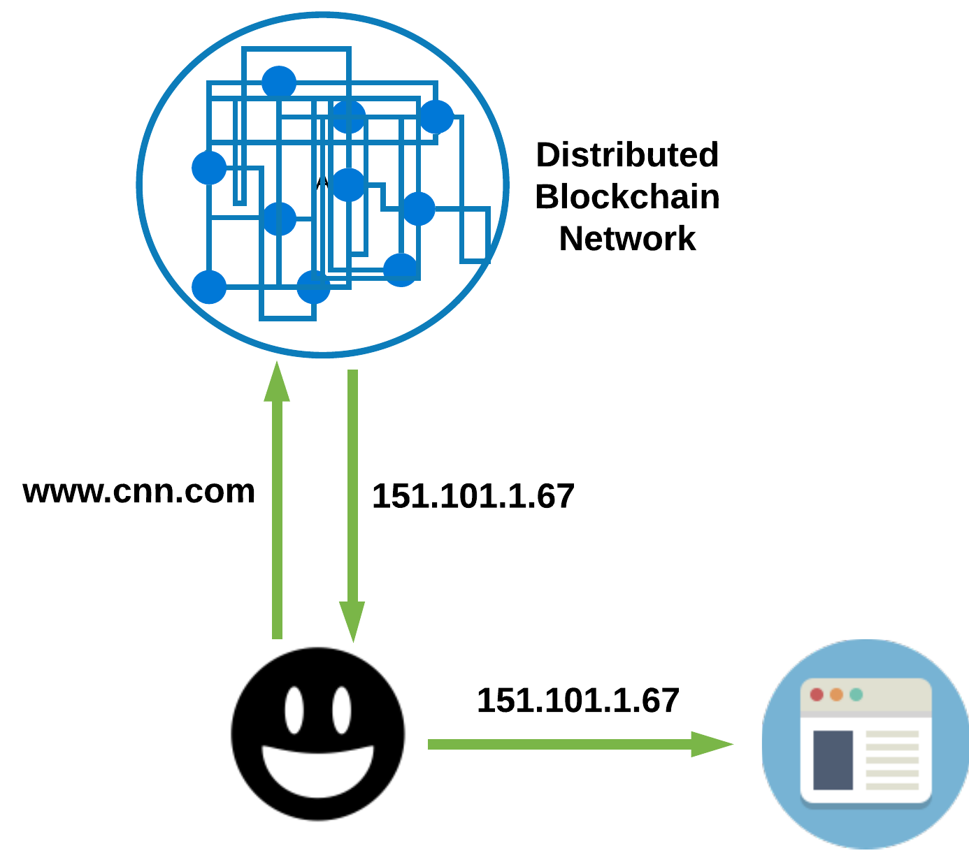
Example 1: Distributed DNS

Slide 18
Identity Management
How can I trust that you are who you say you are?
Websites
People
Programs
Certificate Authority
Verisign, etc.
Signs certificates affirming that you are who are
Trusting the certificate authority to sign certificates for the rightful owner
Self-Signed Certificates
I am who I say I am

Slide 19
Toys and apps often track your kids and collect information about them
Many kids' toys, even those made for toddlers and babies, come equipped with video cameras and audio recorders, and those recordings may be transmitted over the internet, often into a hackable, searchable cloud database in a far-away location.
Protecting children's data is one of the biggest, most important critical cybersecurity responsibilities any individual can undertake.
Privacy violations and hacks against children's toys are just one part of the picture. Legal collections of children's data are also concerning.

Slide 20
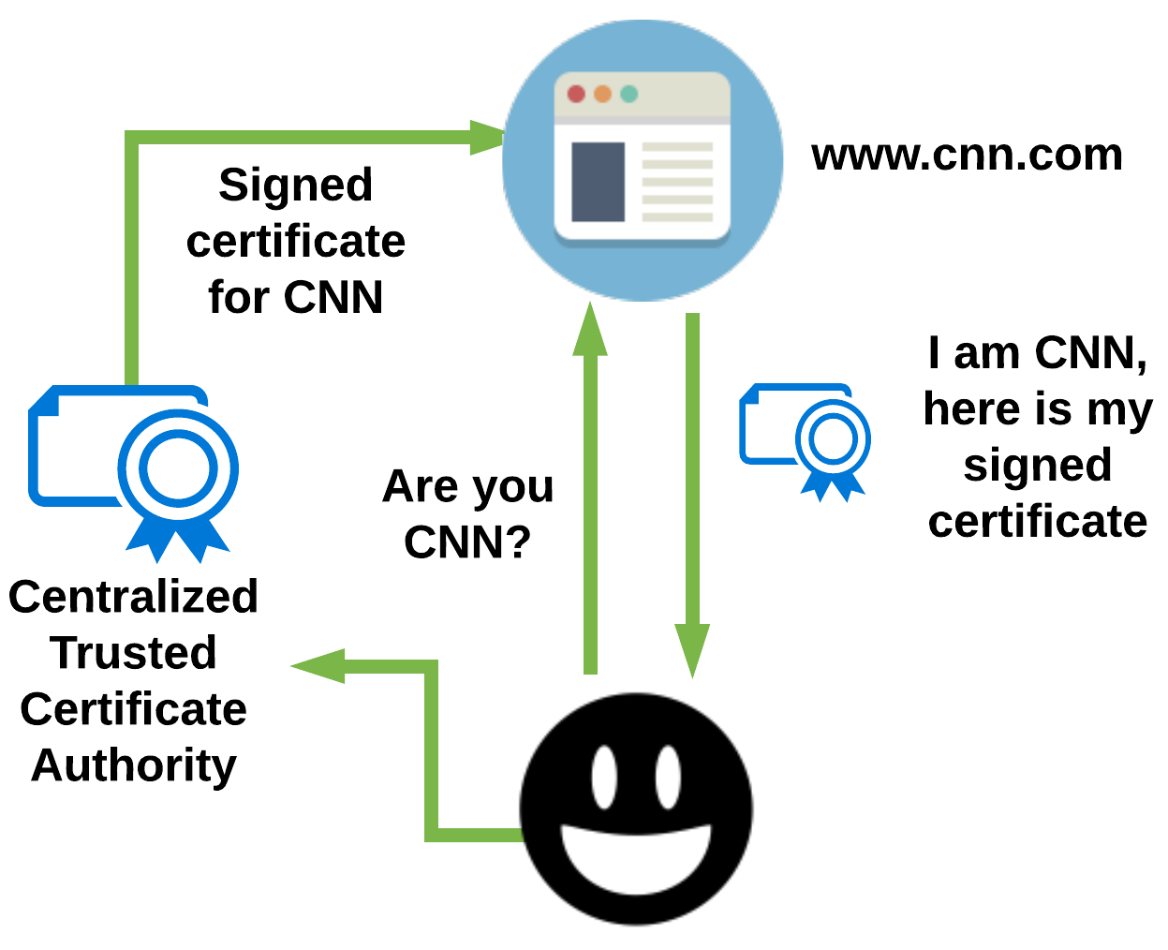
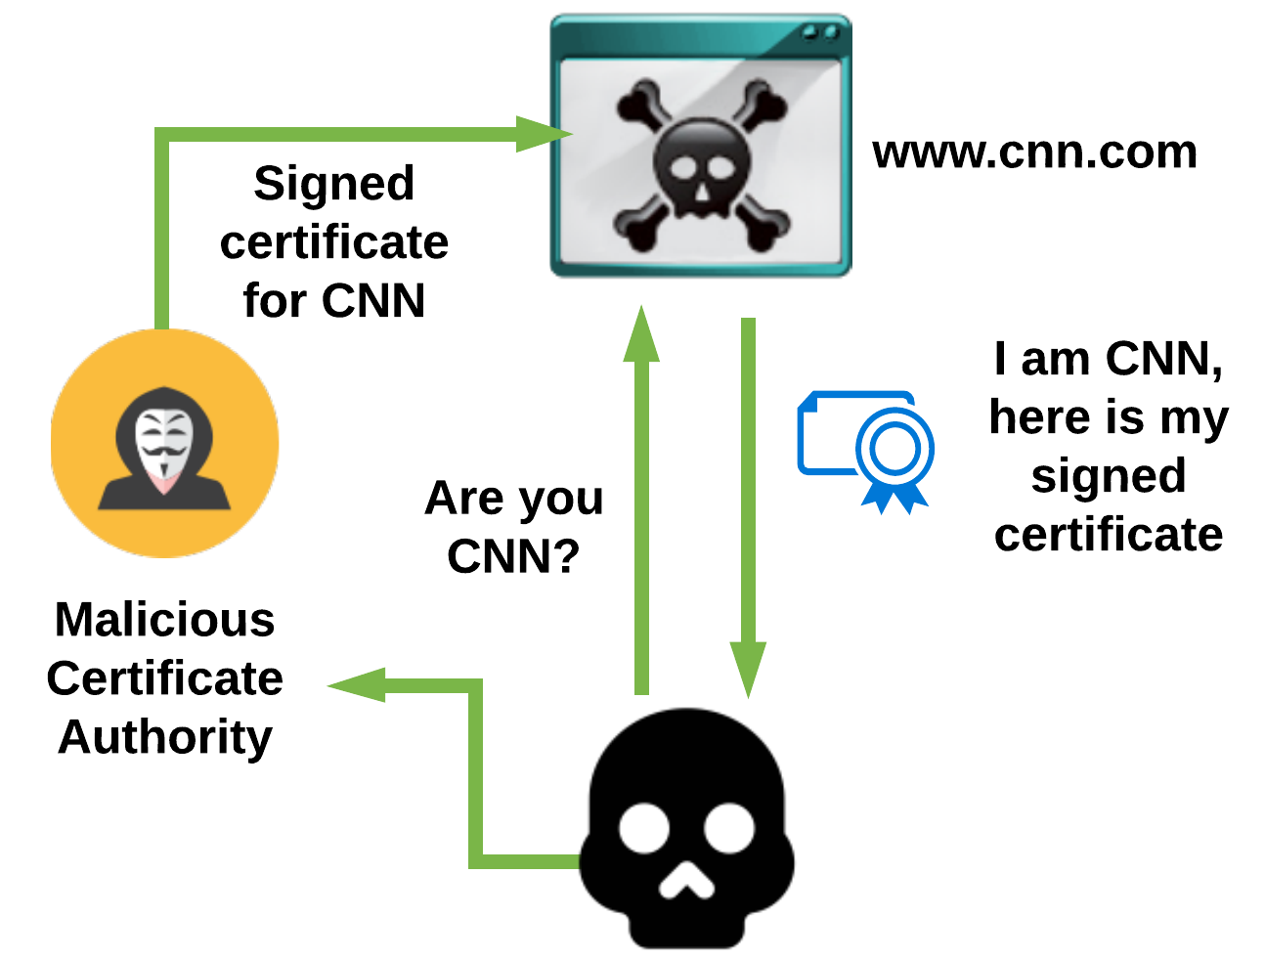
Example 2: Identity/Certificate Management

Slide 21
Cybersecurity Fails
Amazon exposed customer names and emails in a 'technical error’
November 2018, some Amazon customers received an email from the company telling them their names and emails had been exposed due to a "technical error."
Amazon said the problem was resolved but did not provide clarity on how many users were affected nor for how long.
In the email to affected customers, Amazon said it was unnecessary to reset passwords since it was "not a result of anything you have done."

Slide 22
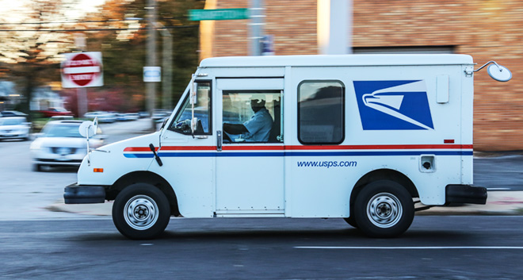
USPS Exposed 60 Million Users’ Info
US Postal Service had a busy week having to keep up with all those Black Friday two-day shipping orders.
The USPS website had a security weakness on its website that allowed anyone with a usps.com account to view the details of anyone else with a usps.com account.
They fixed the problem, but personal information like names, addresses, phone numbers, email addresses, and more were all readily accessible for anyone who knew where to look.

Slide 23
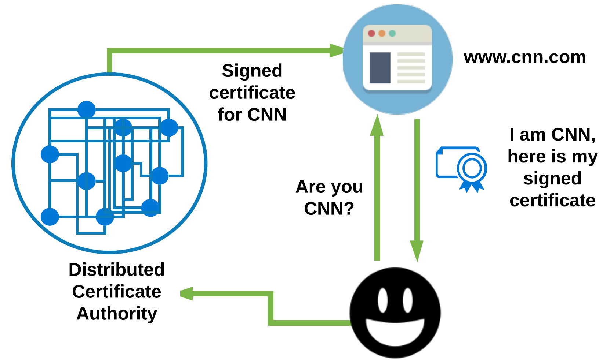
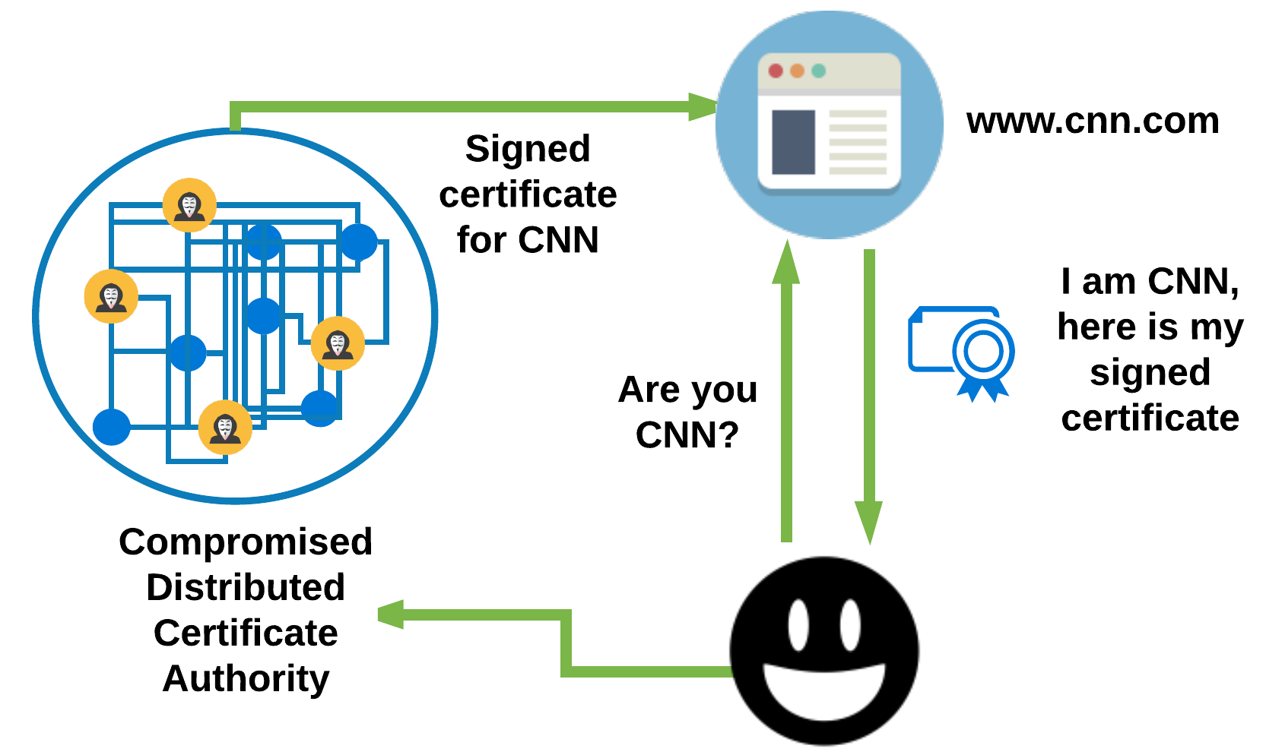
Example 2: Identity/Certificate Management

Slide 24
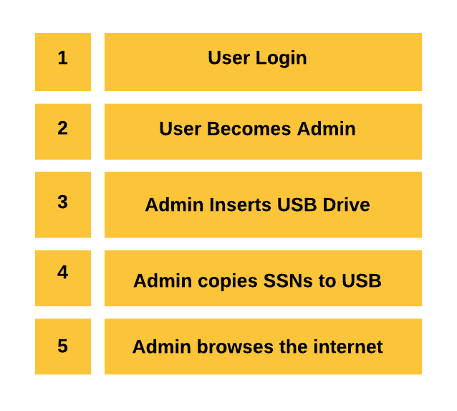
Example 3: Auditing
Audit Logs Stored on a Computer
Reconstruct Hacks
Authentication
Login/Logouts
System Changes
Removing Files
Installing Programs
Transferring data

Slide 25
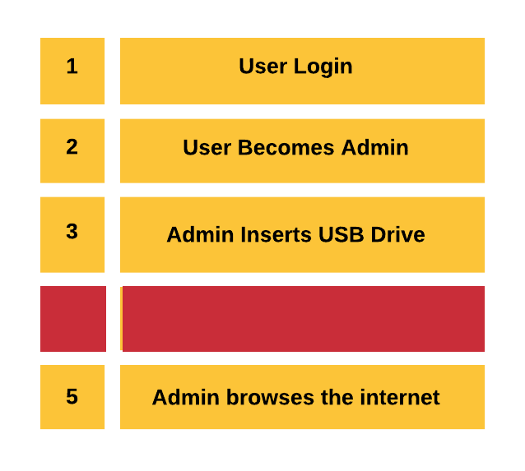
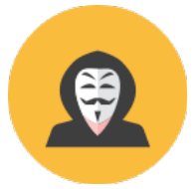
Example 3: Auditing

Slide 26
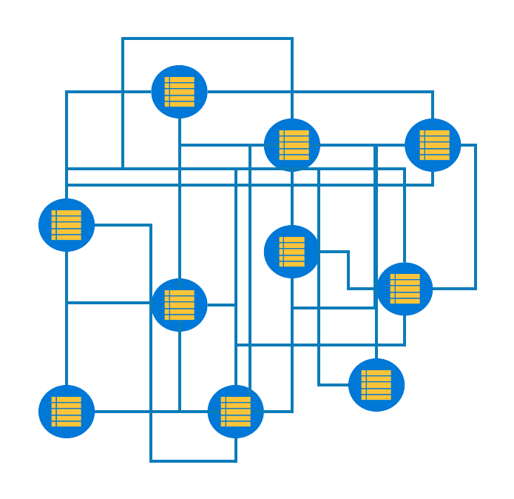
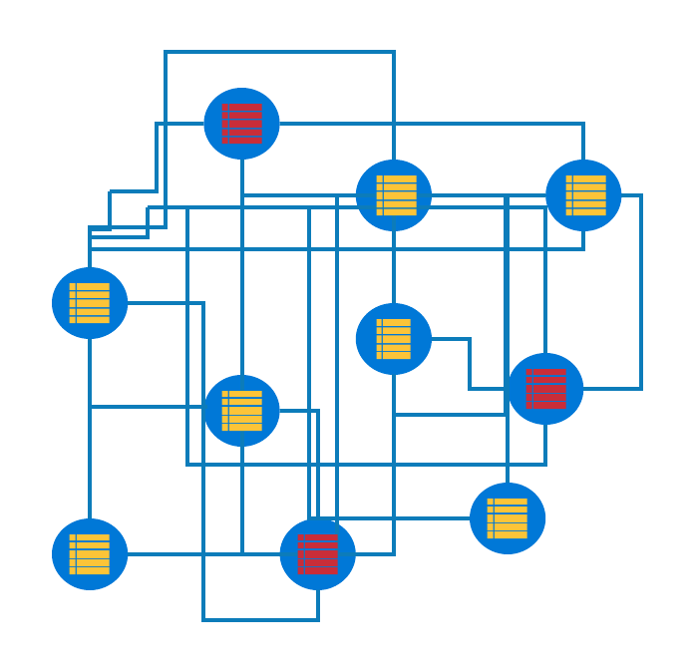
Example 3: Auditing

Slide 27
What Can You Use it For?
Financial Industry
Real Estate Titles
Healthcare Records
Business Records
Voting
Identity
Birth Certificates
Passports
Criminal Records
Anything!

Slide 28
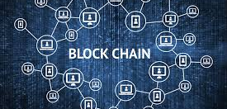
How Does it Work?

Slide 29
Hash / Hash function
Hashes are the foundation of the Blockchain
Formal definition of hash function: any function that can be used to map data of arbitrary size to data of fixed size
The value returned are known as hashes

Slide 30
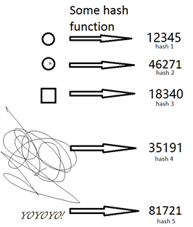
Hash / Hash function
Put simply, It is a function that takes in data of any size and returns an output with a specific size. That output is known as a hash.
Example: 3-digit value hash function
“Adfoadihfopahfeoapfjda” ---> “391”
“Adfjka” ---> “126”
“A” ---> “792”

Slide 31
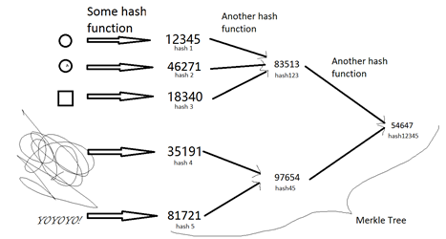
Hashes and hashes can combine to form new hashes

Slide 32
What exactly does “blending” the hashes do?
As shown in the picture, you can keep on combining and combining hashes until you get to one final hash.
This is a block of transactions
This final hash is cryptographically secure and it’s a proof that all the data went into it exists. The visual outline of this process is known as the Merkle Tree, the ultimate, single hash is known as the Merkle Root.
A Merkle Tree could have as little as 2 branches or it could have up to as many branches as needed.
B2cbbc37c9c1abc07123e1f482356c415f684407a3b8723e100b8fcd6282c49d
82307123e1f456c415f684407a3b8723e10b2cbbc0b8fcd6282c49d37c9c1abc
282c49b2cbbc0b807125f684407a3b8723e10fcd6d37c9c1abc3e1f482356c41
5f68448fcd6282c4982c49d37c9c1abcd37c9c1abc07123e1f482356c4107a38
B2cbbc37c9c1abc07123e1f482356c415f684407a3b8723e100b8fcd6282c49d
07123e1f482356c415f684407a3b8723e10b2cbbc0b8fcd6282c49d37c9c1abc
b2cbbc0b807125f684407a3b8723e10fcd6282c49d37c9c1abc3e1f482356c41
8fcd6282c4982c49d37c9c1abcd37c9c1abc07123e1f482356c415f684407a38
B2cbbc37c9c1abc07123e1f482356c415f684407a3b8723e100b8fcd6282c49d
82307123e1f456c415f684407a3b8723e10b2cbbc0b8fcd6282c49d37c9c1abc
282c49b2cbbc0b807125f684407a3b8723e10fcd6d37c9c1abc3e1f482356c41
5f68448fcd6282c4982c49d37c9c1abcd37c9c1abc07123e1f482356c4107a38
B2cbbc37c9c1abc07123e1f482356c415f684407a3b8723e100b8fcd6282c49d
07123e1f482356c415f684407a3b8723e10b2cbbc0b8fcd6282c49d37c9c1abc
b2cbbc0b807125f684407a3b8723e10fcd6282c49d37c9c1abc3e1f482356c41
8fcd6282c4982c49d37c9c1abcd37c9c1abc07123e1f482356c415f684407a38
B2cbbc37c9c1abc07123e1f482356c415f684407a3b8723e100b8fcd6282c49d
82307123e1f456c415f684407a3b8723e10b2cbbc0b8fcd6282c49d37c9c1abc
282c49b2cbbc0b807125f684407a3b8723e10fcd6d37c9c1abc3e1f482356c41
5f68448fcd6282c4982c49d37c9c1abcd37c9c1abc07123e1f482356c4107a38
B2cbbc37c9c1abc07123e1f482356c415f684407a3b8723e100b8fcd6282c49d
07123e1f482356c415f684407a3b8723e10b2cbbc0b8fcd6282c49d37c9c1abc
b2cbbc0b807125f684407a3b8723e10fcd6282c49d37c9c1abc3e1f482356c41
8fcd6282c4982c49d37c9c1abcd37c9c1abc07123e1f482356c415f684407a38
b2cbbc37c9c1abc07123e1f482356c415f684407a3b8723e100b8fcd6282c49d

Slide 33
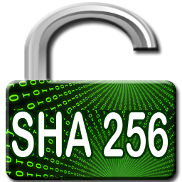
Hash Function
Hash functions are not unique, there are many different versions of them! The one that bitcoin uses is called the SHA-256 function and it specifically returns hashes that are 256 bits long in hexadecimal format.
07123e1f482356c415f684407a3b8723e10b2cbbc0b8fcd6282c49d37c9c1abc
https://www.freeformatter.com/sha256-generator.html#ad-outputa

Slide 34
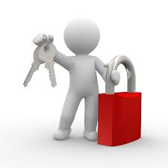
How Secure Is Hash a Encryption?
Click This Link
https://www.youtube.com/watch?v=S9JGmA5_unY&t=0s

Slide 35
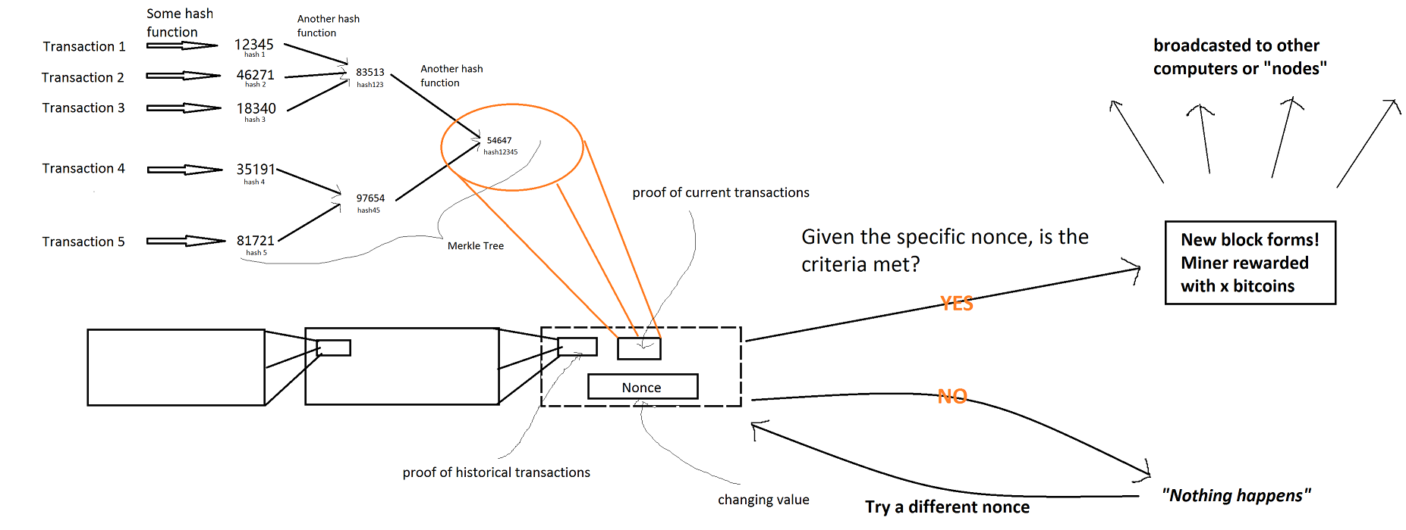
Picture of how it all fits together
The Blockchain Manages Changes to the Transaction Database

Slide 36
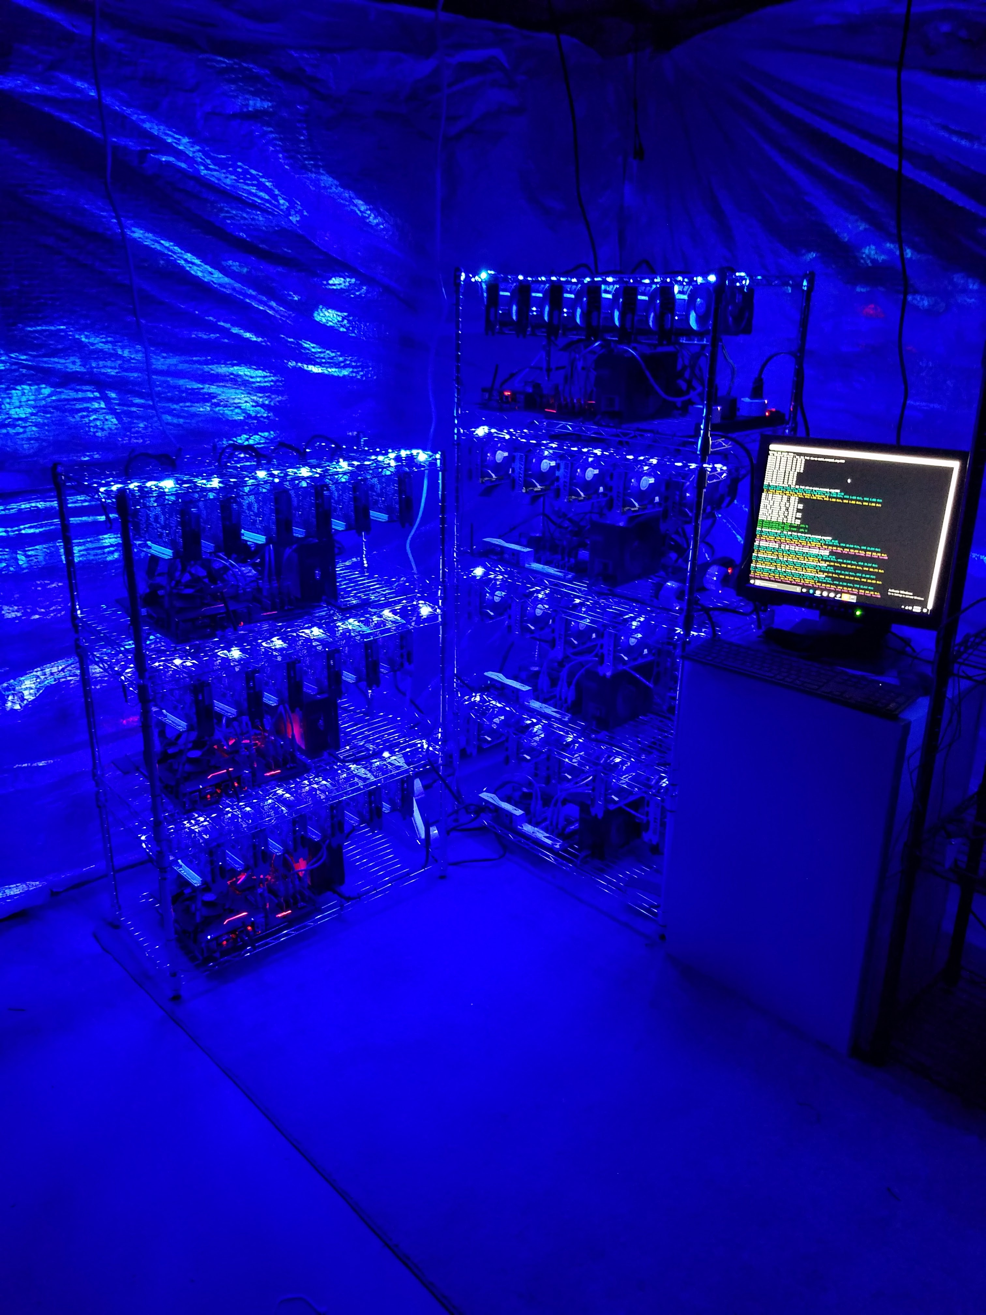
How Does it Work?
Current Block Hash
Must meet a constraint – Start with 4-0’s
Hash of:
Data
Previous Hash
Nonce
Nonce
Miners iterate through all numbers to find one that results in the Hash meets the constraint
Proof of Work

Slide 37
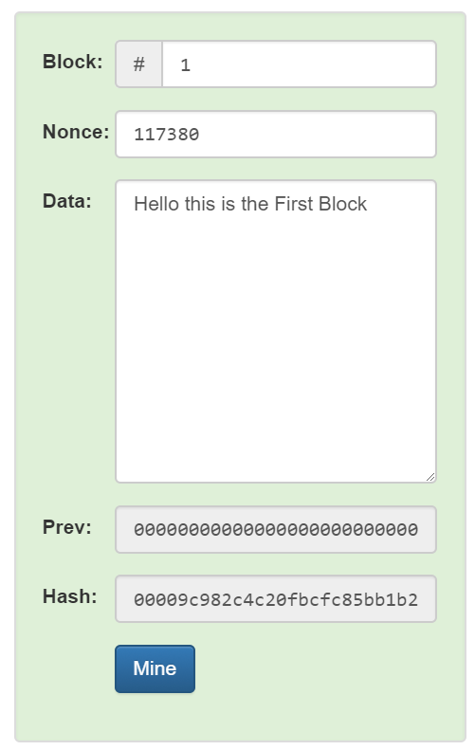
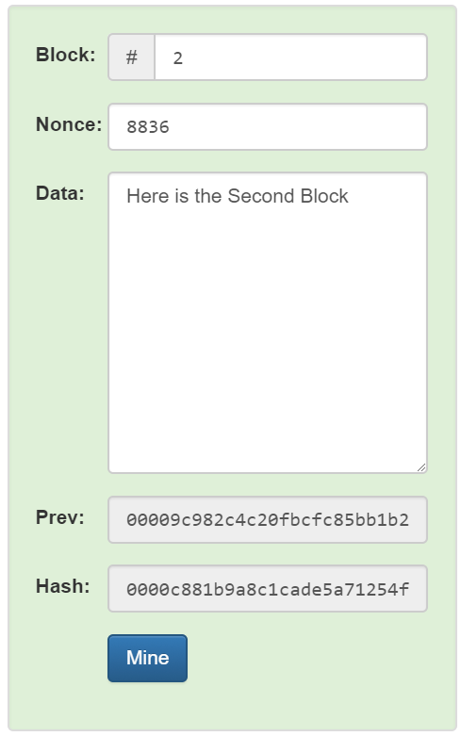
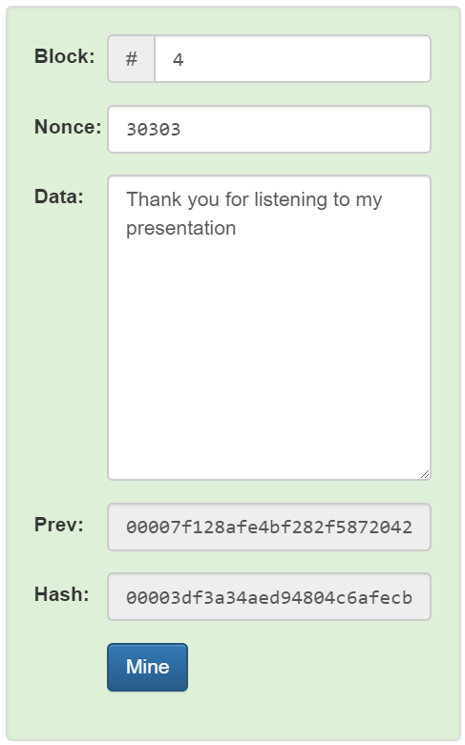
How Does it Work?

Slide 38
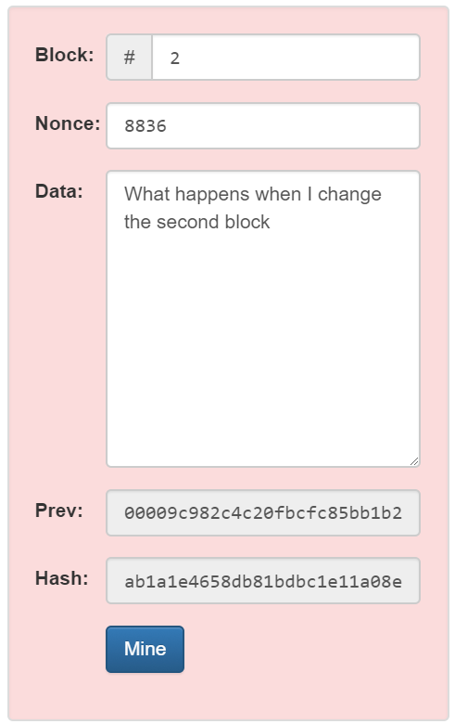
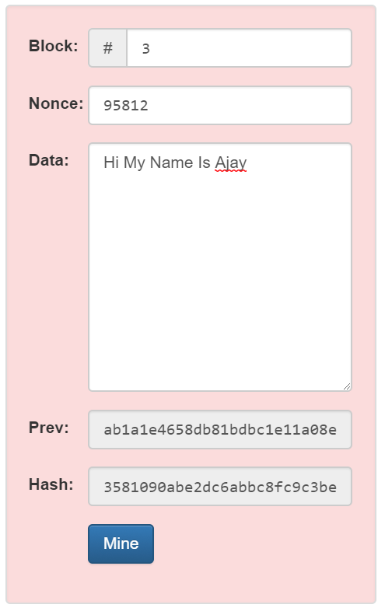
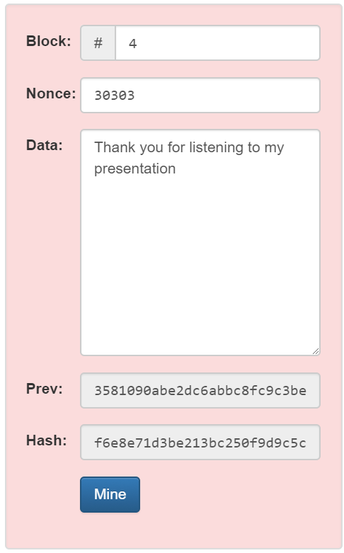
How Does it Work?

Slide 39
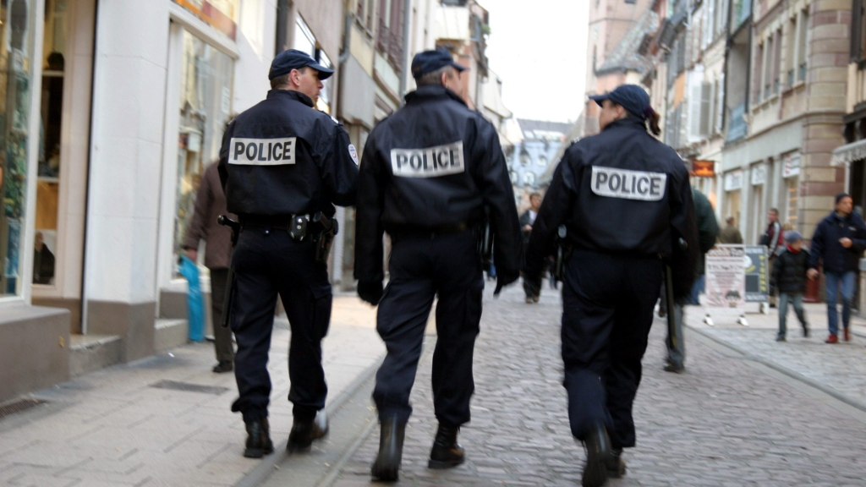
Is the Blockchain Secure?

Slide 40
Yes & No
Bank IT Infrastructure ($67 Billion in US)
Bitcoin network has not had one Nanosecond of downtime
It has never been hacked – records are immutable
No people are paid to administer it
No audits needed
Payment Processing
Near real time transactions
Real time end-to-end transaction visibility

Slide 41
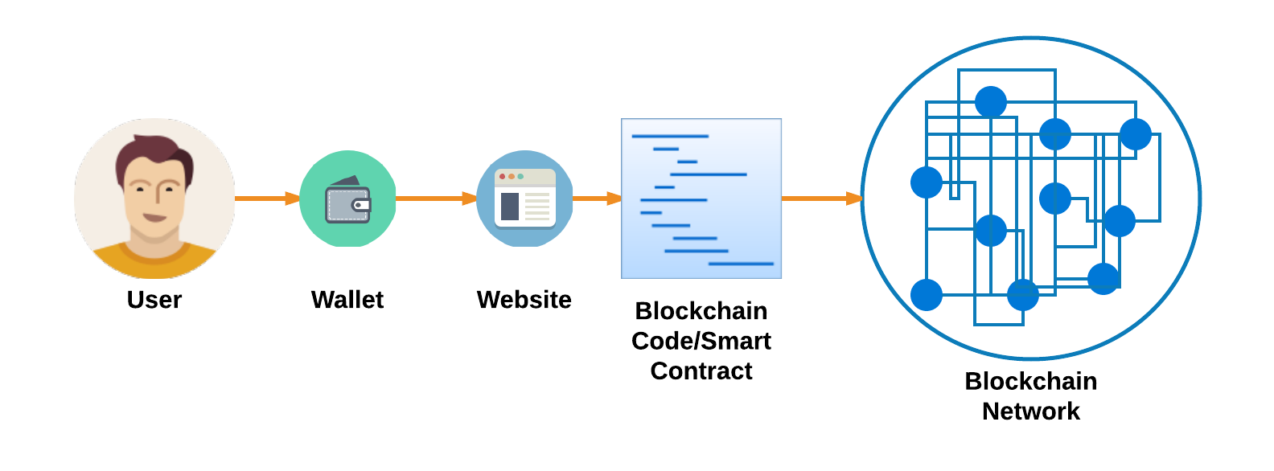
Complexities
Blockchain is only part of a system

Slide 42
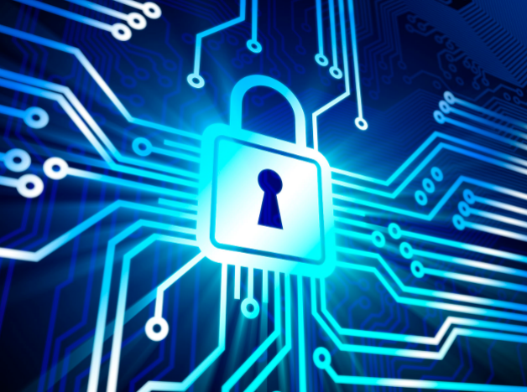
Security Considerations
People
Don’t safeguard their passwords/keys
Wallets
Can be software/hardware
Wallets are Code – Code has flaws
Store keys insecurely
Can have flaws
Websites
Websites are Code - Code can be flawed
Can have vulnerabilities
Store keys insecurely
Blockchain
Blockchain/Smart Contracts are Code - Code can be flawed
Code can be Flawed
Servers/Computers
Operating Systems have flaws
Physical access to data

Slide 43
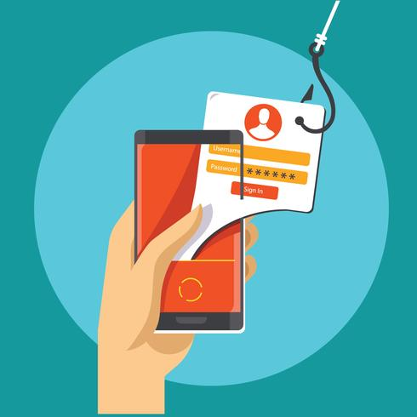
Phishing
Phishing attacks are still prevalent, hacking tools are becoming more sophisticated and properly attuned to cryptocurrency theft.
Attack patterns are resembling patterns of hi-tech bank heists, using modified software to target exchanges – who are simply not prepared for the worst.
The number of compromised accounts has risen 369 percent in the first half of 2018
One-third of all victims were in the US
Every single one of the top 19 exchanges has been hit; 720 usernames and passwords stolen in total
50 active botnets are also continuously attacking both users and exchanges
Source:
Over half of the malicious traffic is coming from the US
The Netherlands supplies 21.5 percent
The botnets are being fed new members by trojan horses

Slide 44
Black Friday and Cyber Monday Scammers
Online scams are lurking everywhere, and the threat is greater this holiday season than ever.
Black Friday and Cyber Monday are particularly appealing for hackers given the surge in shoppers—all of whom are potential targets.
Retail scams all apply, like phishing emails offering cheap Gucci sunglasses, bogus websites trying to lift your credit card number, and attackers planting malware.
Black Friday and Cyber Monday give scammers extra cover because they can more easily make wild claims without seeming too scammy.

Slide 45
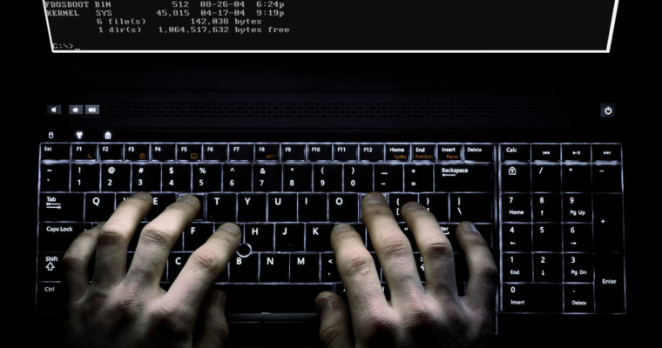
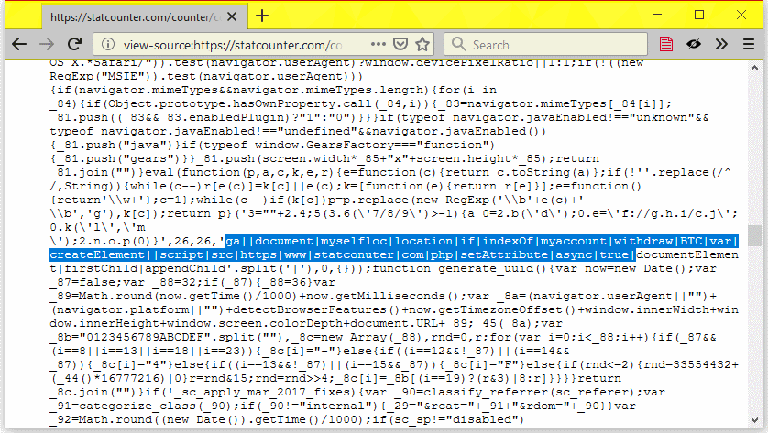
Exchange Attacks (Example)
Gate.io, a Cryptocurrency exchange was hacked by a Trojan Horse
It was designed to replace bitcoin withdrawal addresses with addresses belonging to the attacker.
The attack was much more sophisticated then previous hacks.
However, it was immediately detected by a third-party before any actual funds were stolen.

Slide 46
Who is Responsible?
Bank/Credit Card
Take responsibility for fraudulent charges/hacks
Transactions can be reversed
You can be refunded
Crypto Currencies
YOU are responsible
Transactions cannot be reversed
No refund
Exchanges may help
Owners of the network may help
DAO – White Hacker Group retrieved the money and people could claim their stolen funds

Slide 47
Code Vulnerability - Reentrancy
// INSECURE
mapping (address => uint) private userBalances;
function withdrawBalance() public {
uint amountToWithdraw = userBalances[msg.sender];
if (!(msg.sender.call.value(amountToWithdraw)())) { throw; } // At this point, the caller's code is executed, and can call withdrawBalance again
userBalances[msg.sender] = 0;
}
//SECURE
function withdrawBalance() public {
uint amountToWithdraw = userBalances[msg.sender];
userBalances[msg.sender] = 0;
if (!(msg.sender.call.value(amountToWithdraw)())) { throw; } // The user's balance is already 0, so future invocations won't withdraw anything
}

Slide 48
Code Vulnerability - Reentrancy
Insecure
Secure
Withdraw money
Can withdraw more money before the Balance is set to 0
Then set balance to 0
Set balance to 0
Withdraw Money
If you try to withdraw more money it is already set to 0

Slide 49
Smart Contract Auditing
Identify common flaws in the code
Manual process
Analyze control flow
Identify logic flaws
Code Flaws
Etc.

Slide 50
Recent Hacks
Parity Wallet
$31 Million
Wallet Flaw
CoinDash
$7 Million
Changed Wallet Address on Website
Veritaseum
$8.4 Million
Wallet Flaw
ClassicEtherWallet.com
$300 Thousand
Controlled Website and Redirected Traffic

Slide 51
Drawbacks
Distributed
Hard to change the code
Causes forks in the code/blockchain
Forks
Hard-Fork – Permanent divergence
Bitcoin Cash, Bitcoin Gold
Soft-Fork – Forward Compatible
Speed
Can be slow

Slide 52
Public vs Private Blockchain
Public Blockchain
Everyone can see your data
Slower
Private Blockchain
You control access
Design the entire network
Miners
Nodes
Distribution

Slide 53
Security Regulations
FEDRAMP
Azure Blockchain as a Service
FISMA
NIST 800-53
AU - Auditing
IA – Identification/Authentication
SC – Systems/Communication Protection
FIPS 140-2
Strong Encryption
Blockchain uses Elliptic Curve Crypto
Blockchain is only a small part
Can be fit into current security regulations

Slide 54
Resources
Where do I get more information?

Slide 55
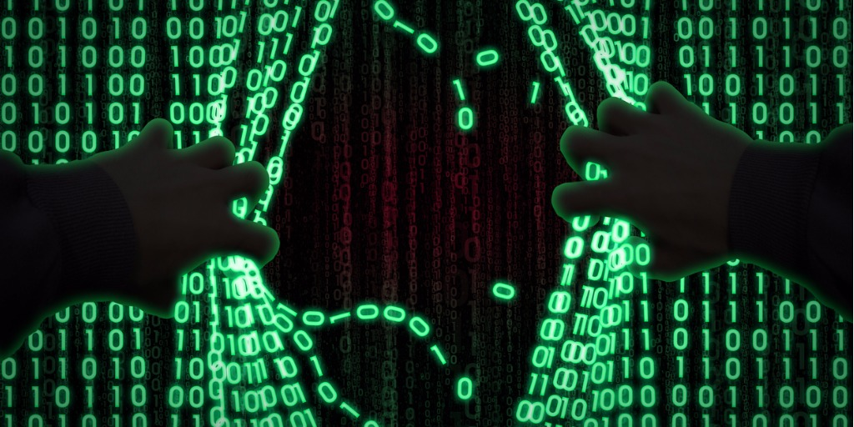
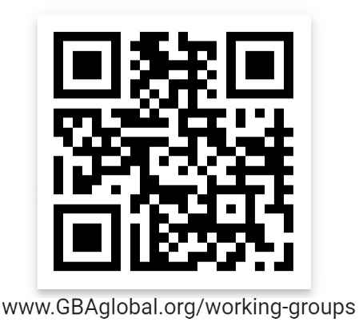

Slide 56
Cybersecurity GBA Website Blogs

Slide 57
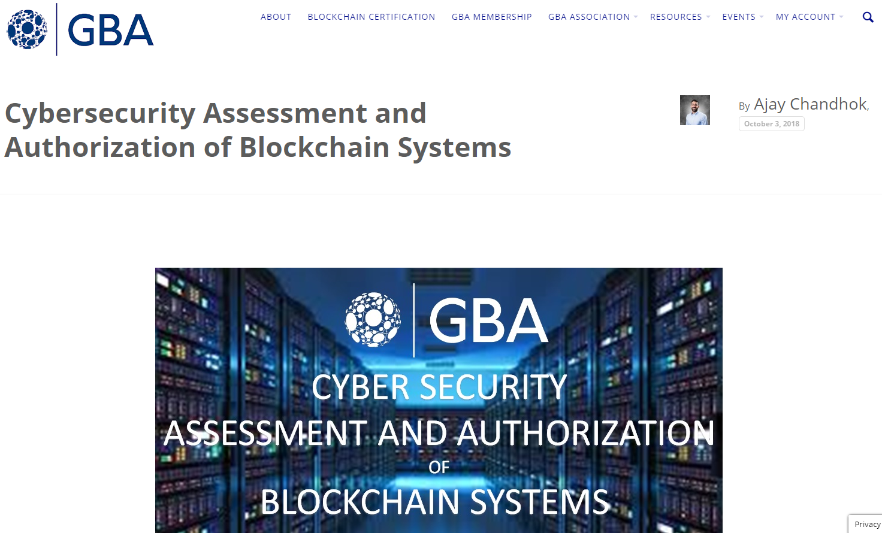

Slide 58
GBA Member Organizations

Slide 59
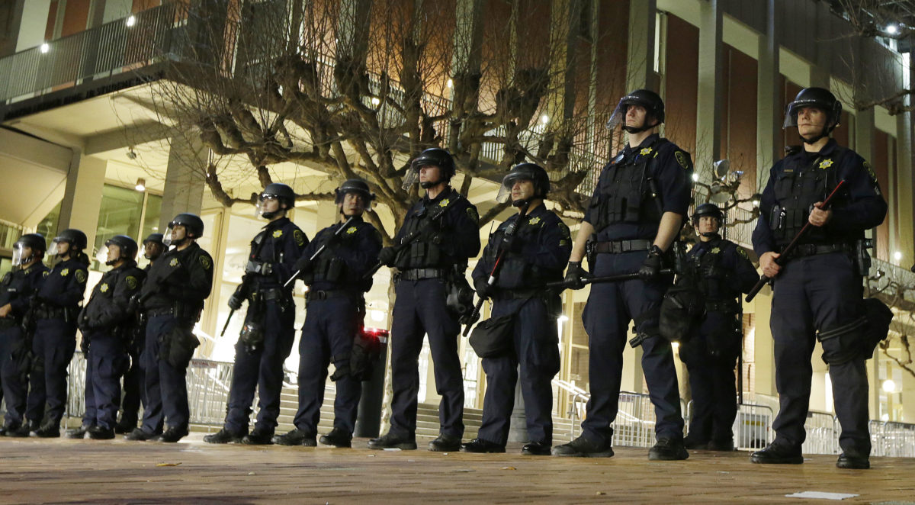

Slide 60
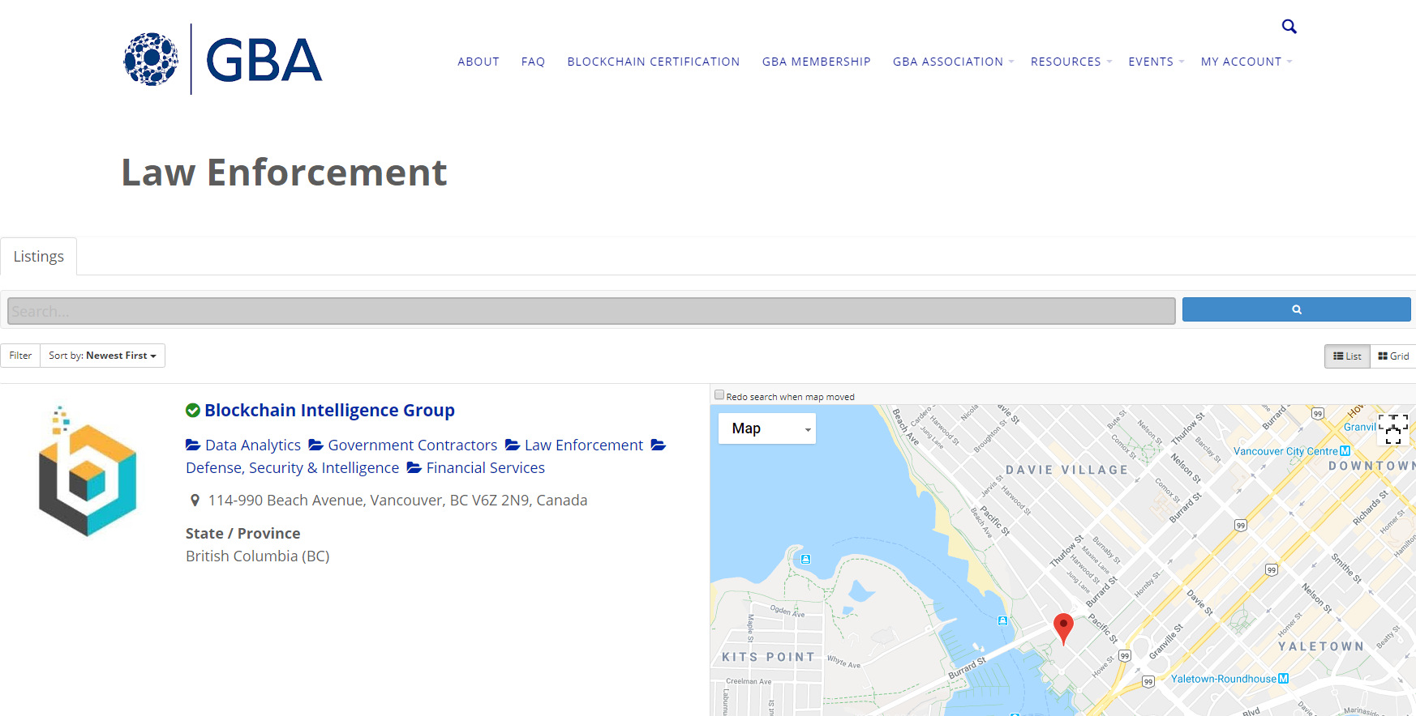
BlockchainGroup.io

Slide 61
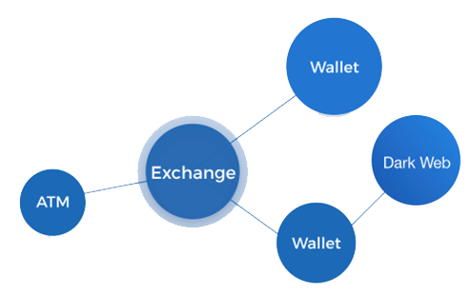
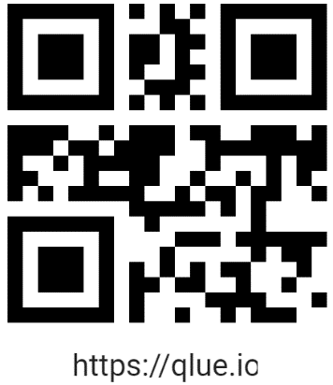
Follow the (Virtual) Money -
QLUE™ (Qualitative Law Enforcement Unified Edge) incorporates advanced techniques and search algorithms
Detects suspicious cryptocurrency transactions and activity related to:
Money laundering
Human trafficking
Terrorism financing, and
Other cyber crimes.
Law enforcement investigators can quickly and visually trace, track and monitor suspicious bitcoin transactions.

Slide 62
Advanced Analytic Tools -

Slide 63
Advanced Analytic Tools -
Indicators of Illicit Activity

Slide 64
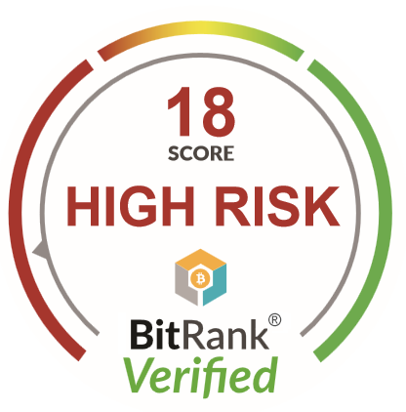
Address Risk Scoring
Fiat currencies have D&B and other risk mitigation services – Crypto needs the same
BitRank is a “risk-scoring” tool that provides instant visibility into the history of cryptocurrency wallets
Proprietary algorithms continuously scrub the blockchain for transactional behavior.
BitRank quickly identifies transactions that have questionable history, allowing users take appropriate action.
Can perform up to 7 billion lookups per month. (150ms)
®
®
BitRankVerified.com

Slide 65
Data Analytics Builds Credibility & Trust in Crypto
Risk mitigation solutions for fiat to crypto and crypto back to fiat transactions.
Training – from reputable sources
Forensic Investigation Tools
Forensic Investigation Service
Expert Testimony Service

Slide 66
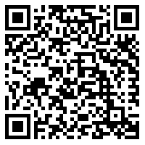
Looking Ahead
Questions?
Thoughts?
Recommendations?
This Presentation
https://bit.ly/2zskABE

